Slide 1

Modeling Basics/ Intro to R
Reading: 0.1, 0.2
exercises: All chapter 0
Assigned: hw 1
Producer: dr. mario
img credit: alex riegert-waters

Slide 2
Course Website / Syllabus
Access Course Website Through Canvas
Cover Syllabus
Office Hours
Grading and Curving
Attendance: UNC Check-In App
Homework
Quizzes
Exams
PDFs and Gradescope
Grade Disputes
Honor Code
Usage of Course Website and Canvas

Slide 3
Course Website / Syllabus
Access Course Website Through Canvas
Cover Syllabus
Office Hours
Grading and Curving
Attendance: UNC Check-In App
Homework
Quizzes
Exams
PDFs and Gradescope
Grade Disputes
Honor Code
Usage of Course Website and Canvas

Slide 4
Data
Data are numbers with a context.
Departures from a Pattern
Data
=
Pattern
+
How do we identify the actual pattern?
How do we characterize the departures (errors)?

Slide 5
Statistical Modeling
Find a model for a relationship between a response variable (Y) and one (or more) predictor/explanatory variables (X₁, X₂, ..., X_{k}).

Slide 6
Purposes for Statistical Modeling
1. Making predictions
2. Understanding relationships
3. Assessing differences

Slide 7
Types of Variables
Quantitative: expressible as numbers for which arithmetic makes sense
Categorical: divides sample points into groups
Binary = categorical with just two groups

Slide 8
Two Main Themes of STOR 455
Types of Response
Quantitative
Categorical
Types of Predictors
Quantitative
Categorical
(1)
(2) Allow for models with multiple predictors.

Slide 9
Building a Statistical Model: Four Step Process
1. CHOOSE – Pick a form for the model
2. FIT – Estimate any parameters
3. ASSESS – Is the model adequate? Could it be simpler? Are conditions met?
4. USE – Answer the question of interest

Slide 10
General form of a model:
Random Error
“Expected” Y for some combination of predictors
=
+
Data
Model
Error

Slide 11
Example: Lego Prices
Question:
How can we predict the price of a Lego set?
Data: Attributes of Lego sets, including their current sale price on Amazon
Predictor variables: Start with none.

Slide 12

Example: Constant Model
where c is an (unknown) constant
Terminology:
The constant c is a parameter of this model.
We use data to provide a sample estimate of c.
How should we estimate $c$ from data?

Slide 13


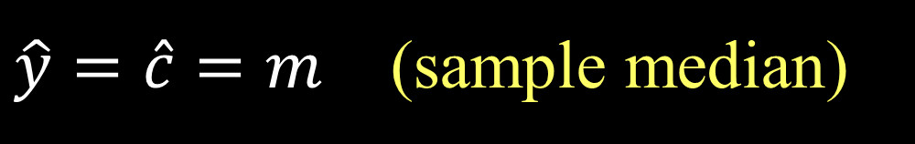

Predicted Value for Response
Get an estimate for Y using the predictors and the model with estimated parameters.
Notation: The predicted y is denoted $\hat{y}$
For the constant model: $\hat{y}=\hat{c}$
Examples:
$\hat{y}=\hat{c}=\overline{y}$ (sample mean)
$\hat{y}=\hat{c}=m$ (sample median)

Slide 14
Questions
(1) Which estimator (mean or median) is better?
i.e. How can we compare models?
(2) Is either model any good?
i.e. How can we asses fit?

Slide 15
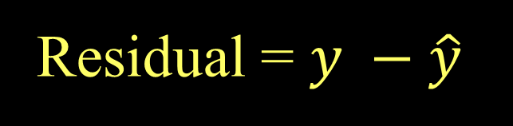
Residuals
Using the predicted value for each sample case the residual is
Residual = $y −\hat{y}$
Predicted
Actual

Slide 16



Criteria to Minimize Residuals?
Sum of residuals: $\sum{(y−\hat{y})}$
Sum of absolute deviations: $\sum{\left|y−\hat{y}\right|}$
Sum of squared errors: $\sum{{(y−\hat{y})}^{2}}$

Slide 17
Technology
We need software to automate computations…
R – a free, widely used, open source statistics package
Rstudio – an interface for R

Slide 18
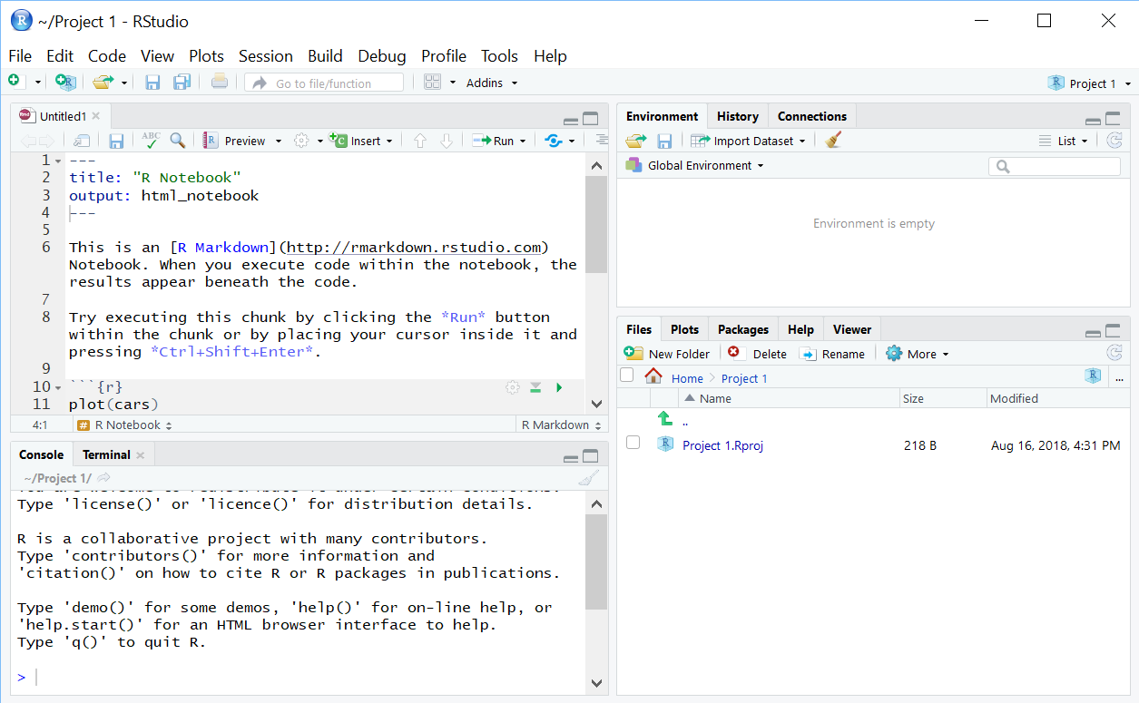
RStudio
Environment: lists active variables, functions, …
Editor: write/view code, data
Access files
View plots
Control packages
View help
Console: Enter commands, view output, error messages

Slide 19
A First RStudio Session
Load the Lego data into R
Summarize the Amazon_Price variable
Numerical: mean and median
Graphical: histogram, boxplot
Compute and evaluate residuals

Slide 20
A First RStudio Session
Load the lego data into R
```{r}
# loads a package needed to use the read_csv() function
# install package before first using it for the first time
library(readr)
# loads the lego dataframe into the environment from GitHub
lego <- read_csv("https://raw.githubusercontent.com/JA-McLean/STOR455/master/data/lego.csv")
# Alternative way to load dataframe (remove # to use)
# lego.csv must be saved in the same folder as this notebook!
#lego <- read_csv(“lego.csv")
# Shows the variables and first 6 cases (by default)
head(lego)
```

Slide 21
A First RStudio Session
Summarize the Amazon_Price variable - Numerical: mean and median
# dataframe$variable_name
mean(lego$Amazon_Price, na.rm = TRUE)
median(lego$Amazon_Price, na.rm = TRUE)
[1] 57.8232
[1] 37.325

Slide 22
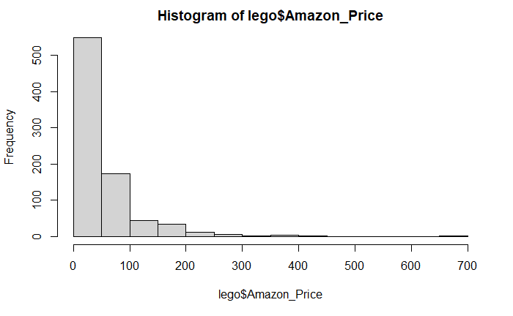
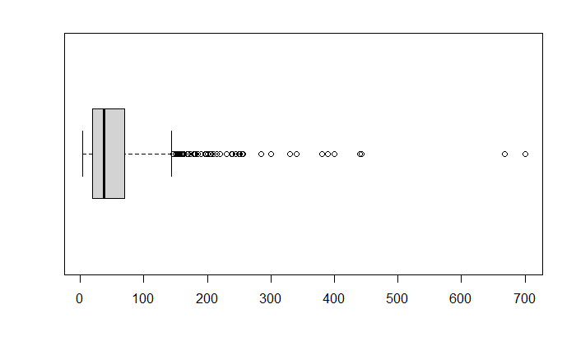
A First RStudio Session
Summarize the Amazon_Price variable - Graphical: histogram, boxplot
hist(lego$Amazon_Price)
boxplot(lego$Amazon_Price, horizontal = TRUE)

Slide 23
A First RStudio Session
Compute and evaluate residuals
# removes NA Amazon_Prices
lego_rm_AP_na = subset(lego, is.na(Amazon_Price) == FALSE)
# Assignment operators in R: = vs. <-
xbar = mean(lego_rm_AP_na$Amazon_Price)
m = median(lego_rm_AP_na$Amazon_Price)
residxbar = lego_rm_AP_na$Amazon_Price - xbar
residm = lego_rm_AP_na$Amazon_Price – m
sum(residxbar^2)
sum(residm^2)

Slide 24
Can we use a predictor to improve the model?
X = Number of Pieces in the Lego set?
See Chapter 1
X = Theme of the Lego set?
Two-sample t-test for a difference in means
(comparing only two themes)

Slide 25
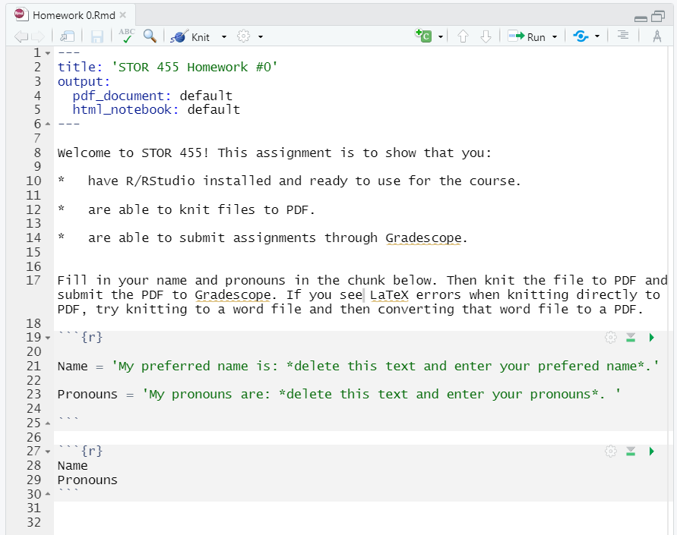
Homework 0

